Slide 1
Miniproject I: API Queries
Niklas Bergen
July 23, 2021
Notes:
Include introduction to yourself on this slide
Feedback: could have maybe used world population to normalize movie revenue. Make note of key insights.

Slide 2
Outline
Objectives
Tools Used
Results
Challenges

Slide 3
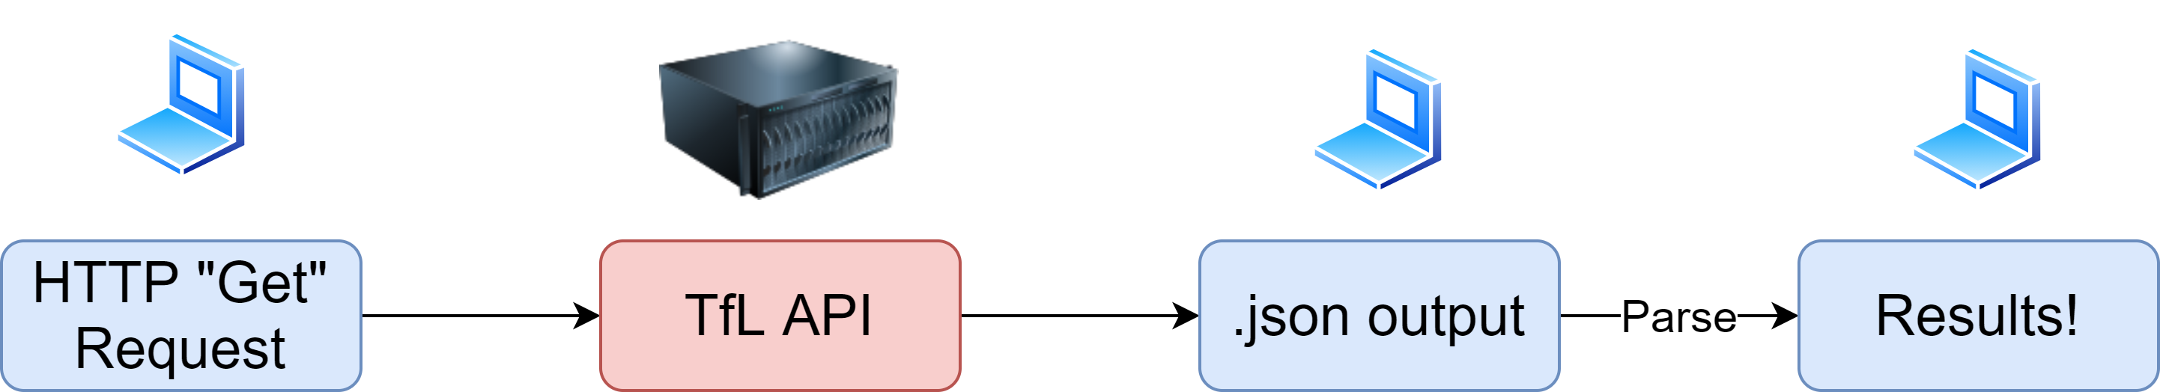
Objectives
Test API functionality

Slide 4


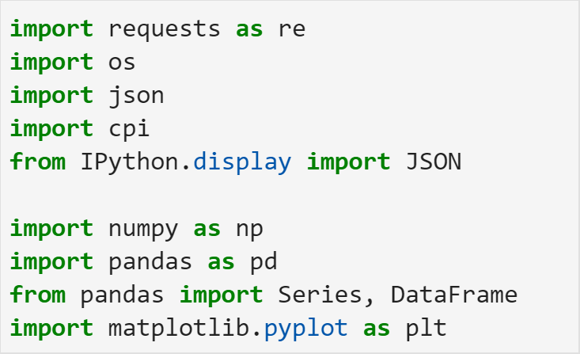

Tools Used
Jupyter Lab
Packages

Slide 5
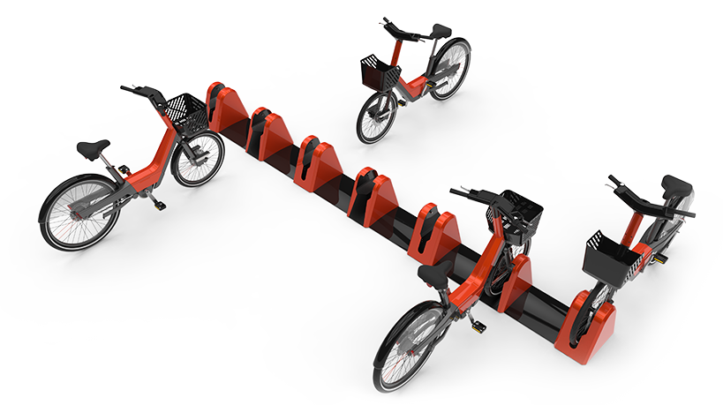
Results
Bike Stations

Slide 6

Results
Favorite Movie Analysis:
The Good, the Bad and the Ugly (1966)
The Shining (1980)
The Dark Knight (2008)
Inception (2010)

Slide 7
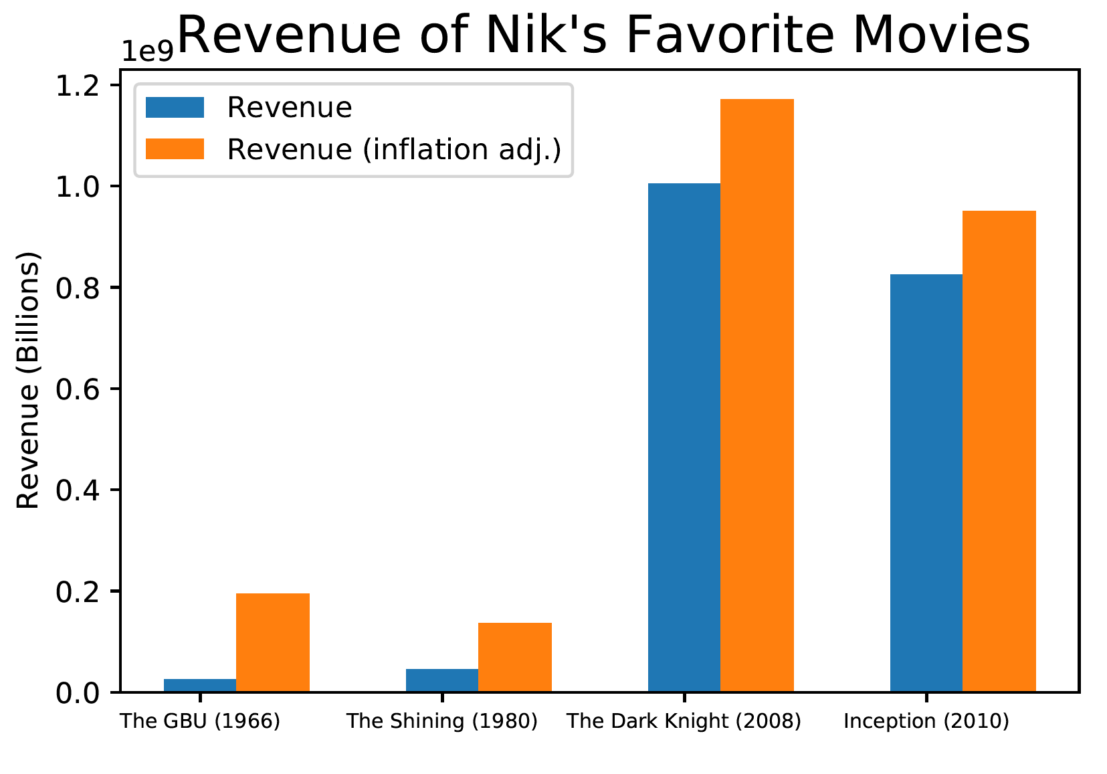
Results
Movie Analysis
Notes:
$1 Billion!
Nobody agreed with me

Slide 8

Challenges
API documentation
Parsing
Pythonic Coding
Notes:
If I had more time: pythonic coding, additional movie stats

